Slide 1
41 and 43
A Comparison of George H.W. Bush and George W. Bush

Slide 2
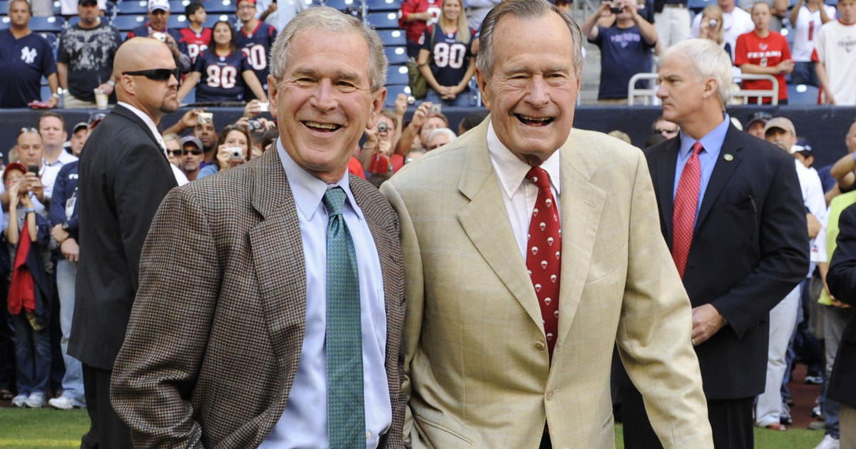

Slide 3
Abstract
Both Bush 41 and Bush 43 served as President
They share many overlapping principles and ideology, yet maintain distinct personalities and style
Although both are Republicans, each man has unique views on social, domestic, and international issues
41 and 43 grew up in political families and were exposed to politics at a very early age – this was the start of their political socialization
Both men inherited struggles in office that often times overshadowed the goals and initiatives that they had laid out on the campaign trail

Slide 4
George H.W. Bush’s Upbringing
Bush 41 grew up in a home where his dad wore a tie to the dinner table and expected his children to do the same
Prescott, his father, was a good father, though detached at times
Bush was a very-well behaved and good-mannered child who rarely acted up
He followed the life plan that has parents had laid out for him because he was very similar to his dad and wanted to live a life like him

Slide 5
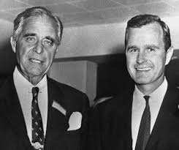
George H.W. Bush pictured with his father, Prescott Bush

Slide 6
George W. Bush’s Upbringing
Bush grew up in a family that was similar to his father’s
Like his dad, he was exposed to politics at a young age
He differed from his father in that he was a troublemaker growing up
43 loved pranking people and is reported to have placed a “kind of high-tech whoopee cushion in a chair for senior political aid Karl Rove” (Cannon & Cannon)
Although his father seldom used foul language, 43 is said to have known all the four-letter words by the age of twelve

Slide 7
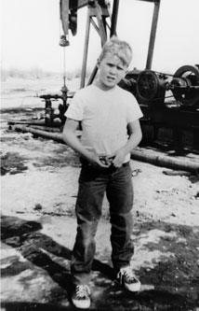

Slide 8
Life Experiences Before Presidency
Both men have nearly identical educational backgrounds – both went to Andover and Yale, though Bush 43 ended up attending Harvard also
When the elder Bush was 18, he joined the Navy and was, at that time, the youngest pilot in the entire Navy
Like his father, 43 also did spent time in the military, but his service was in the National Guard
43’s military service has been a topic of dispute because, when he ran for president, some claimed he had lied about his experience

Slide 9
Business Experience
After spending time in the Navy, 41 got into the oil business, and with the help of his dad, was able to make a few million dollars
43 also got involved in the oil business, but he did not do well at all; he ended up buying the Texas Rangers, where he learned valuable skills that he would utilize later in life
Both men made millions of dollars off their business ventures, which ultimately helped them in their later political careers

Slide 10
Political Upbringing
Bush 41 has a very unique political resume leading him to the presidency– he served as the Congressman for the 7th district of Texas from 1967-1971, was appointed U.S. Ambassador to the UN, served as the Director of the CIA, and was the Chairman of the Republican National Committee before being elected once President of the United States
Bush 43 had significantly less political experience – he ran an unsuccessful Congressional run in 1978, but later won two gubernatorial races in Texas before being twice elected President of the United States

Slide 11
Relationship with Congress & the Judicial
Neither man had superb relationships with the other branches of government
Bush 41 was elected President during a time when both the House and Senate were controlled by the Democrats
He did the best he could to bridge the gap, but often found himself isolated from them
The House attacked him harshly for his views on issues such as abortion

Slide 12
Relationship with Congress & the Judicial
When Bush 43 was elected President in 2000, the public was very unsettled by the fact that the election was decided by a 5-4 Supreme Court vote
Many felt that the Constitution was being pushed to the limits
Nonetheless, Bush was fortunate to experience Republican majorities (though small) in the House and the Senate
In the wake of 9/11, Bush found that, at least for a few months, bipartisanship was fairly easy to come by

Slide 13
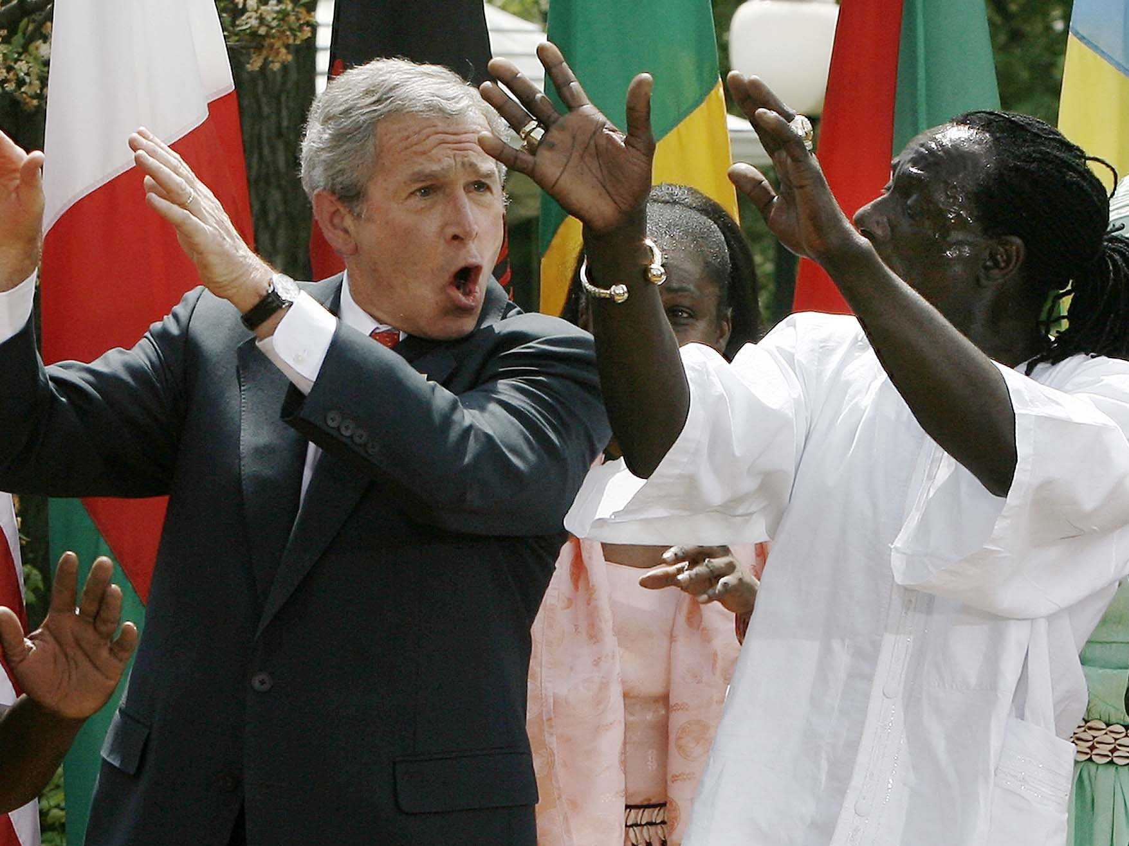

Slide 14
Policy & Public Mood
Although not highly publicized, Bush 41 is not 100% pro-life – he and his wife, Barbara, have even given money to Planned Parenthood (Cannon & Cannon)
When Ronald Reagan handed him the Vice Presidency, 41 quickly pushed his personal views to the side in order to comply with Reagan’s agenda and the far-right Conservative public mood at the time
Bush 41 also promised a tax cut, but ended up losing public support when he passed bipartisan legislation that actually raised taxes

Slide 15
War
Both men were forced to deal with difficult decisions internationally
Bush 41 was successful in pushing Saddam Hussein out of Kuwait, but he stopped short of an invasion of Iraq because he and his advisors were weary of war
Bush 43, with nearly unanimous support of both houses of Congress and the public, invaded Iraq and Afghanistan; public mood started shifting after it was realized that there was no clear exit plan for either of these conflicts

Slide 16
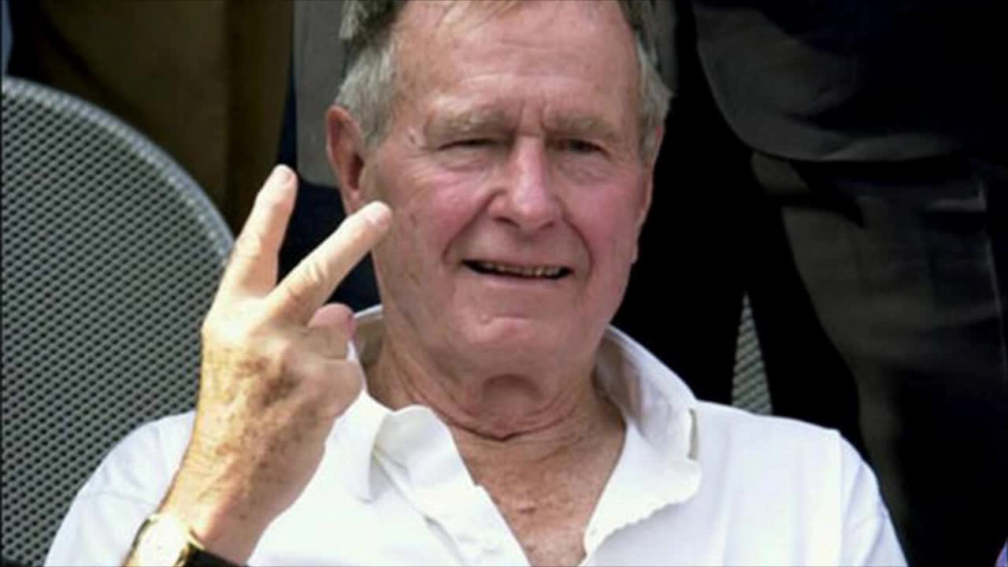
The End

